Slide 1
BlueText
Text Messaging for your computer
Andrew Guibert

Slide 2
Market Opportunity
Text messaging is the most commonly used short message communication platform
Device integration is becoming more popular ( Google Drive, Dropbox, iCloud, SkyDrive )
Proof of concept: Apple’s iMessaging service

Slide 3


Market Opportunity
 | iPhone ( 12.1% ) | Android ( 81.9% )
Mac ( 7.1% )
Windows ( 91.6% )
Source: Net Applications Web Analytics 2013

Slide 4
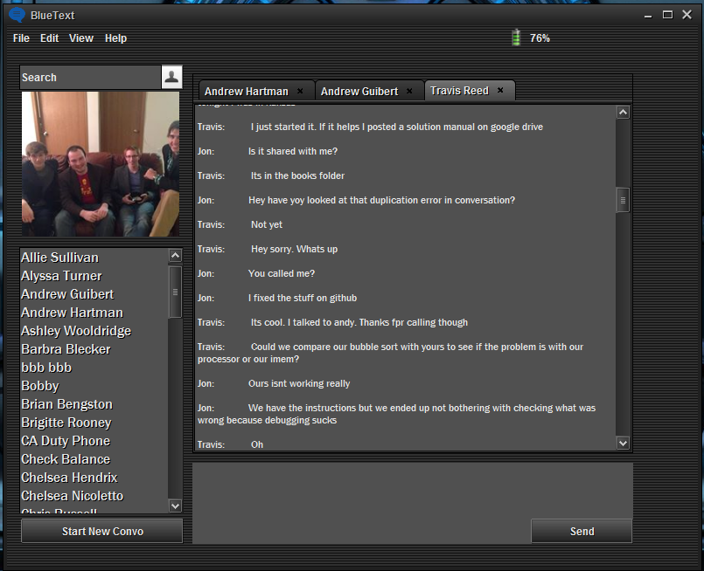
The product

Slide 5
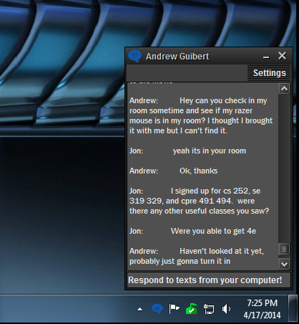
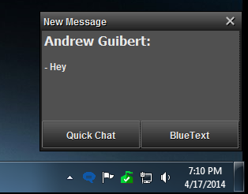
The product

Slide 6
Expected cost and revenue
Expenses:
Developers
Advertising
Databases
Download server
Revenue
In-product advertising
Registration fee
Corporation contracts

Slide 7
Questions?

Slide 8
https://www.youtube.com/watch?v=Zs9SUmxJtVo

